Slide 1
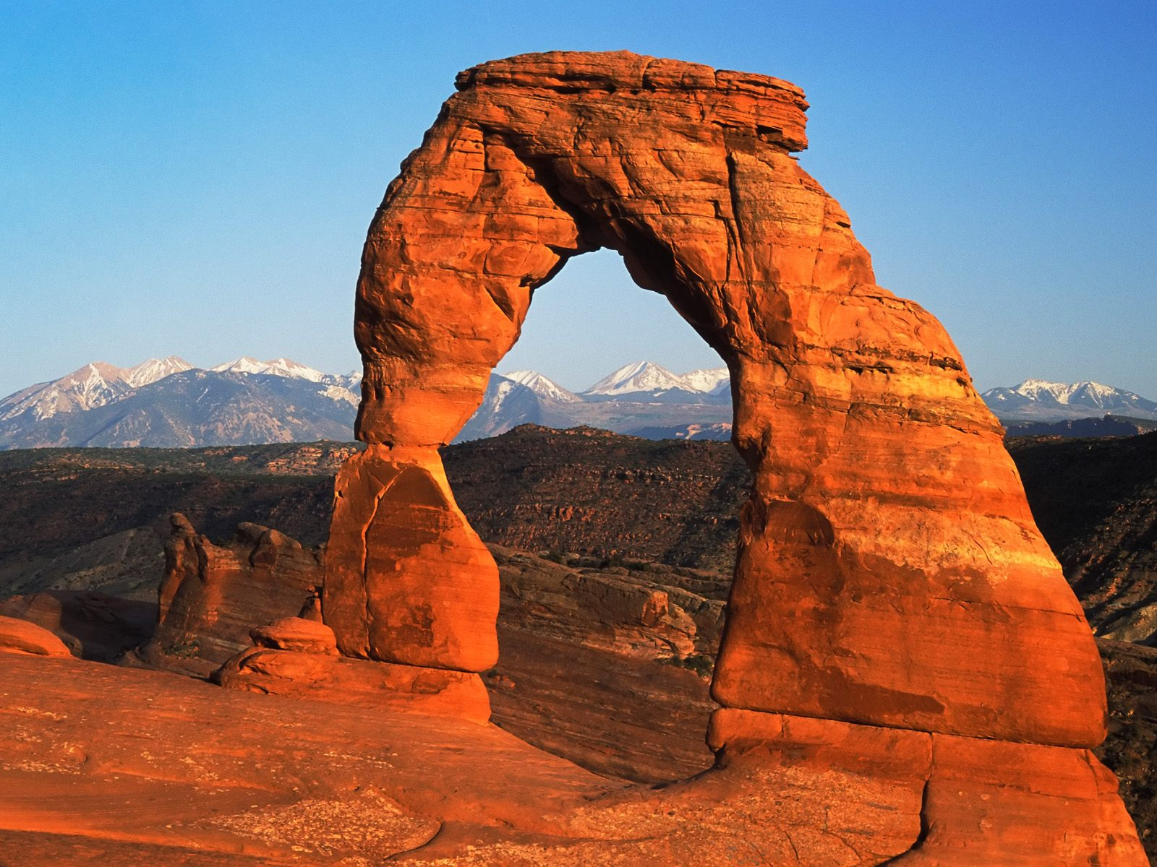
TARGET: After 42 minutes I will be able to…
Identify the factors that influence the rate of weathering.

Slide 2
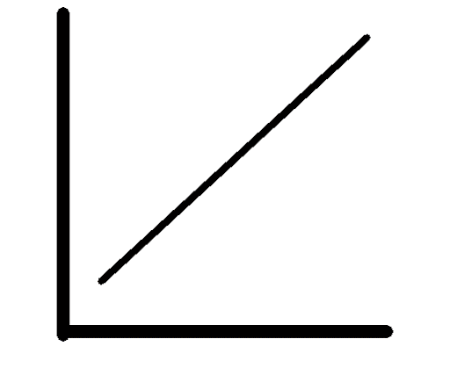
Most weathering processes require….
WATER
DIRECT RELATIONSHIP

Slide 3
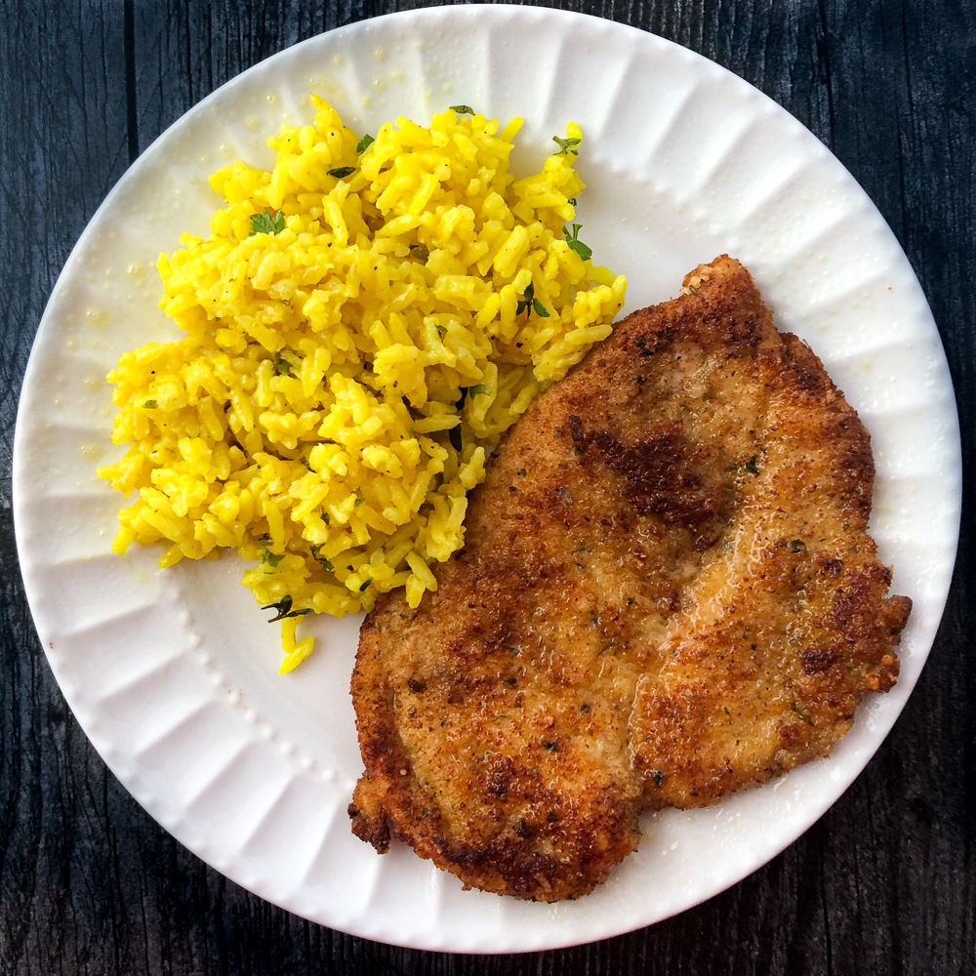
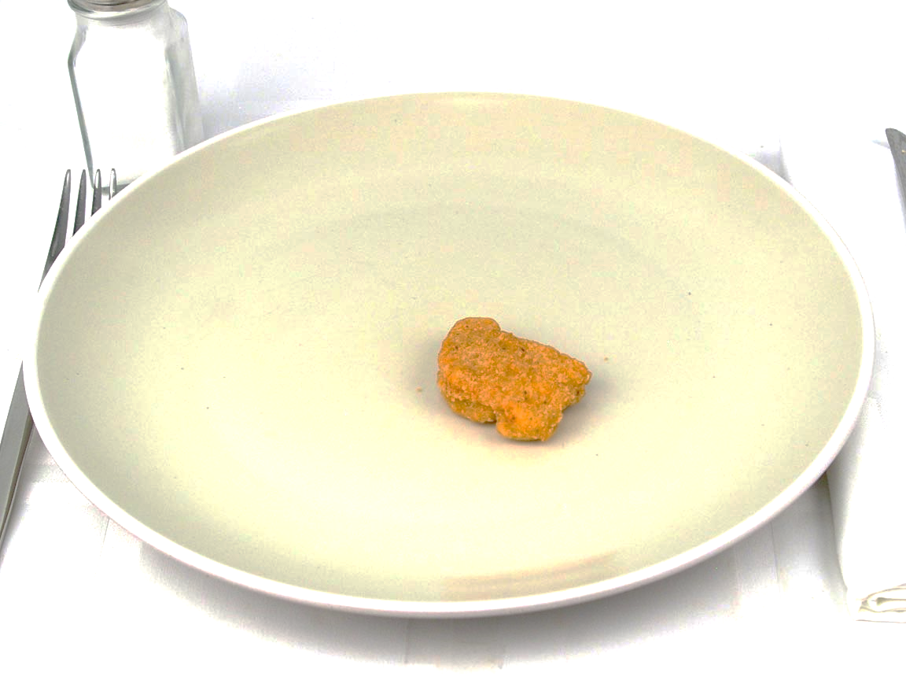
INTRODUCTION QUESTIONS:
Which food item can a toddler eat faster, a chicken cutlet or a chicken nugget? Explain why:
A chicken nugget
because it is smaller

Slide 4
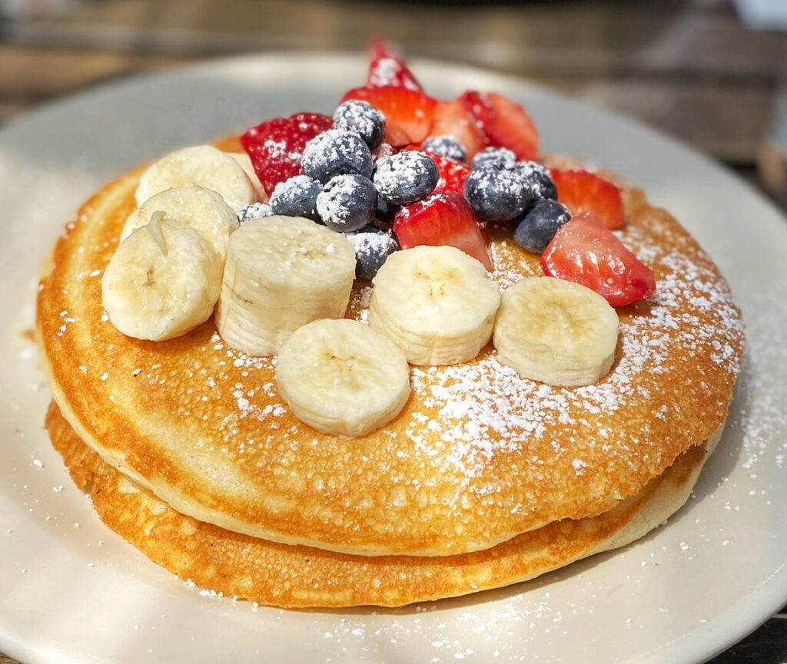
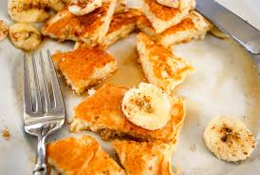
INTRODUCTION QUESTIONS:
2. If a parent wanted to make it easier for the toddler to eat a whole pancake, what could they do to it?
Explain why:
Cut up the pancake because smaller pieces are easier to eat.

Slide 5

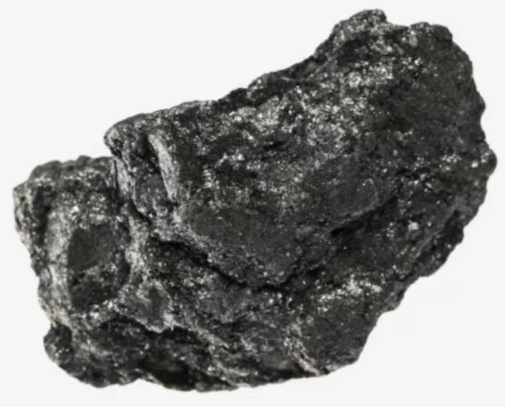
INTRODUCTION QUESTIONS:
3. People say “Diamonds are forever” but not “Graphite is forever” even though both are made up of the element Carbon. Why?
Explain why:
Diamonds have a higher hardness and a difference atomic arrangement.

Slide 6
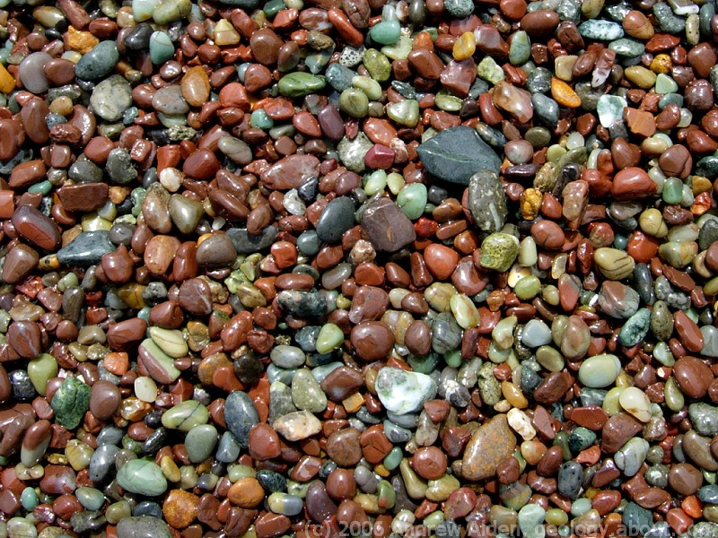
SEDIMENT FACTORS also influence the RATE OF WEATHERING. SUCH AS:

Slide 7
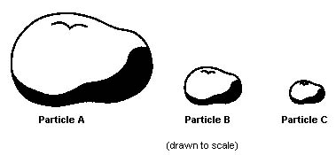
FAST!
1. ____________
SIZE!
SMALL SIZES INCREASE WEATHERING!
SLOW!

Slide 8









RELATIONSHIP?
INDIRECT

Slide 9
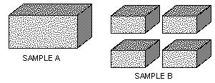
SURFACE AREA
2._____________
MORE SURFACE AREA
INCREASES WEATHERING!
SLOW!
FAST!

Slide 10










RELATIONSHIP?
DIRECT

Slide 11
MINERAL COMPOSITION
3._____________
SLOW!
FAST!
LOWER MINERAL HARDNESS =
HIGHER WEATHERING RATE!

Slide 12









RELATIONSHIP?
INDIRECT

Slide 13
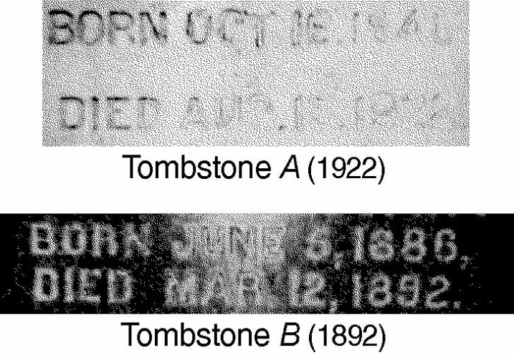
THE POWER OF OBSERVATION… ACTIVITY 1: Which Tombstone has been weathered more? What evidence supports your answer?
A bc its difficult to read!
It may be older, but mineral is softer

Slide 14
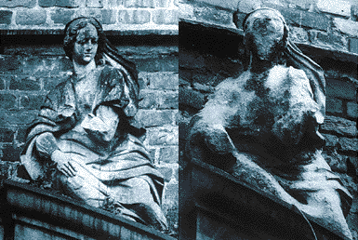
ACTIVITY 2: Which statue has less detail? What could have done this?
Letter B:
Caused by ACID RAIN
A
B

Slide 15
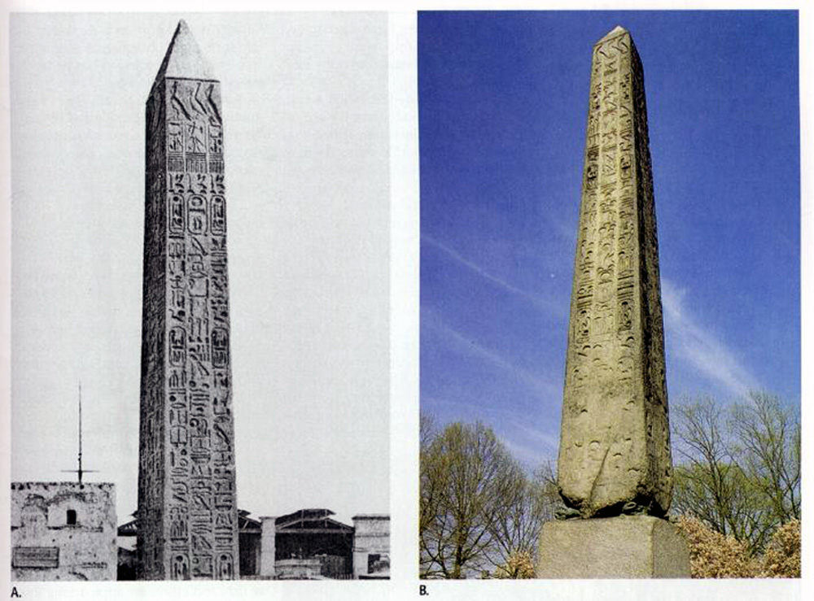
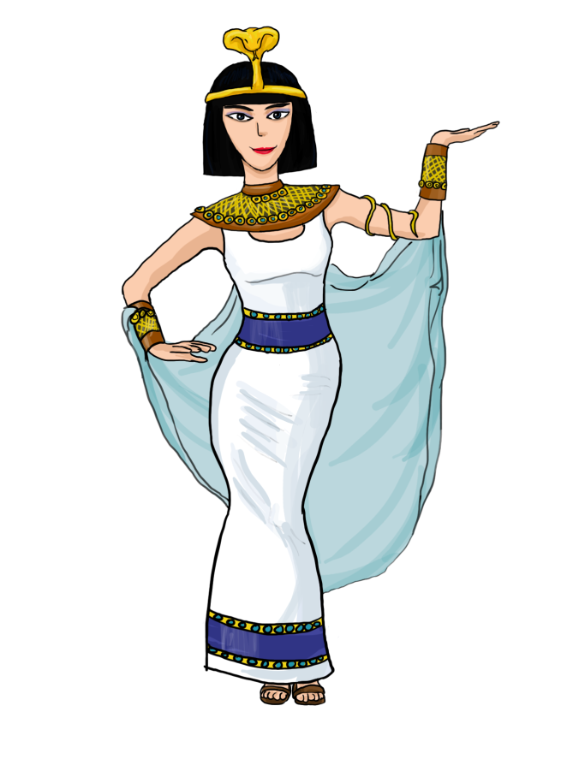
ACTIVITY 3: Q1. Which photograph is easier to read the hieroglyphics?
A
B
A!
This is
Cleopatra’s Needle, an obelisk

Slide 16
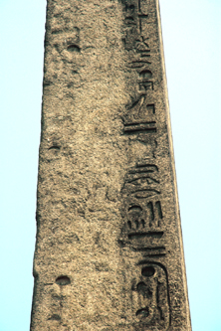

Q2. What happened to the NYC OBELISK?
It weathered away faster because it was moved from
ARID Egypt to
HUMID NYC

Slide 17
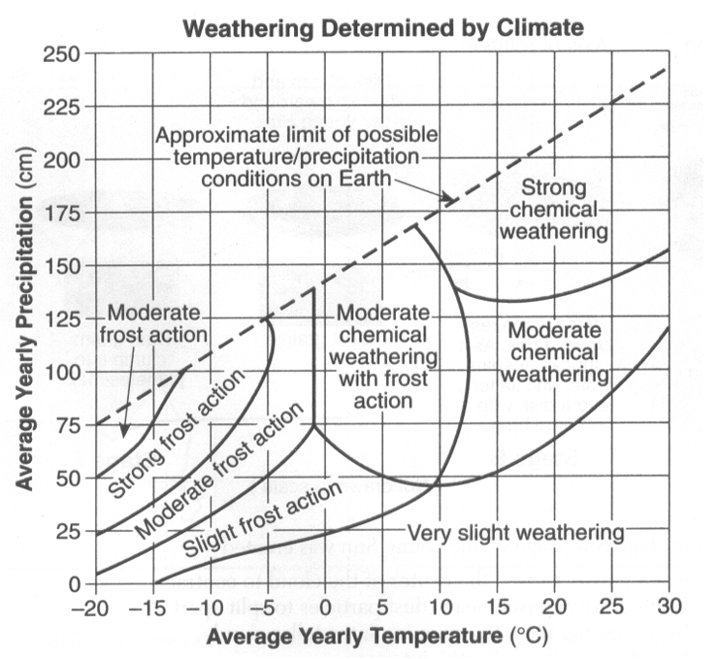
ACTIVITY 4: Use the following graph to answer the corresponding questions.

Slide 18






Circle your answer. Compared to Physical Weathering, the relative temperature of Chemical Weathering is:
Lower Equal Higher
2. Determine an average yearly
precipitation amount that would
cause strong chemical weathering
to occur at 25°C:
Any value from 148cm- 225cm

Slide 19



3. What type of weathering occurs at the following:
25°C, 125 cm
b. -3°C, 40 cm
c. 6°C, 82 cm
Moderate Chemical Weathering
Slight Frost Action
Moderate Chemical Weathering with Frost Action

Slide 20
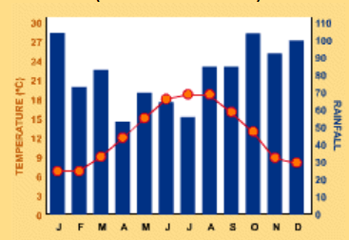
ACTIVITY 5: Use the following climatograph of Ireland to answer the corresponding questions.

Slide 21
Which month do you think will have the fastest rate of chemical weathering?
Explain the reason(s) that you selected this month for question 1.
Which month do you think will have the most Frost Action?
Explain the reason(s) that you selected this month for question 3.
April
High Temperature &
Highest Rainfall
January
Low Temperature &
Highest Rainfall

